Slide 1
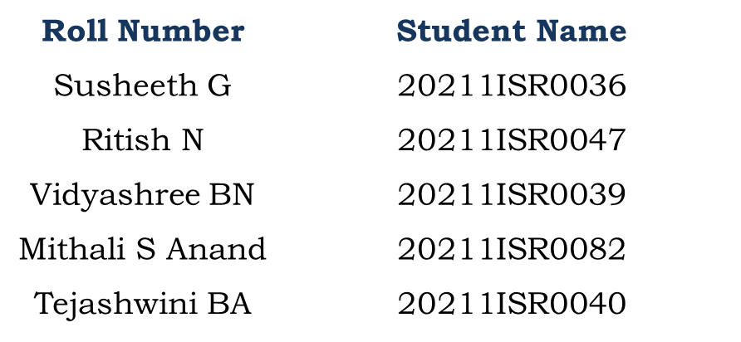
PSCS190-Examination Timetable Generation
PIP104 University Project-II
Review-4
Batch Number:ISR-G03
Under the Supervision of,
Dr. Murali Parameswaran
Professor
School of Computer Science & Engineering
Presidency University
Name of the Program: B.TECH. INFORMATION SCIENCE &ENGINEERING (AI AND ROBOTICS)
Name of the HoD: Dr. Zafar Ali Khan
Name of the Program Project Coordinator: Dr.Afroz Pasha
Name of the School Project Coordinators: Dr. Sampath A K / Dr. Abdul Khadar A / Mr. Md Ziaur Rahman

Slide 2
Introduction
Exam scheduling in educational institutions involves managing constraints like avoiding exam clashes, adhering to room capacities, and fairly distributing invigilation duties. Manual scheduling is error-prone, time-consuming, and inefficient, especially with large datasets and diverse requirements. To address these challenges, this project proposes an Automated Examination Scheduling System using genetic algorithms, which optimize schedules by iteratively refining solutions. The system processes input data via a web interface, generating conflict-free timetables, invigilation assignments, and student room allocations in PDF format. Automation reduces errors, saves time, and ensures fairness, scalability, and efficiency, benefiting institutions of all sizes.

Slide 3
Research Review
1. Dynamic Combined Flow Algorithm for Exam Scheduling: Introduces the DCF algorithm and STAG model for scalable, conflict-free exam scheduling using time slots as edges and real-time adjustments for efficient resource use.
2. Genetic Algorithms with Guided and Local Search Strategies: Combines Genetic Algorithms with Guided and Local Search strategies to create scalable and adaptable university timetables, effectively balancing hard and soft constraints.
3. Preference-Based Firefly Algorithm for Examination Scheduling: Enhances the Firefly Algorithm with stepping-ahead and threshold acceptance techniques to optimize conflict-free exam scheduling, validated on real-world and benchmark datasets.
4. Real-Time Scheduling in Time-Sensitive Networks: Proposes a novel SMT and OMT-based scheduling approach for TSNs, optimizing real-time data flow with fewer schedule entries, benefiting industrial IoT applications.
5. Generic Algorithms for Timetabling Problems: Highlights the need for scalable, adaptable algorithms to address NP-Hard timetabling challenges and improve consistency across diverse scheduling domains.
6. Metro Timetable Recovery After Disturbances: Develops an exact quadratic programming model to reschedule metro operations efficiently during disruptions, improving transit reliability by up to 30%.

Slide 4
Continued..
7. Automated Timetable Generation with Context Reasoning: Introduces a Tkinter-based system to automate university timetabling, reducing conflicts and processing time, with plans for faculty absence adjustments.
8. Survey on Exam Timetabling Methodologies: Analyzes optimization, heuristic, and hybrid methods for solving Exam Timetabling Problems, emphasizing scalability, fairness, and real-world dataset integration.
9. Clustering-Based Task Scheduling for Heterogeneous Processors: Presents CMWSL, a clustering algorithm optimizing processor utilization and schedule length for DAG applications, reducing communication overhead.
10. Evolutionary Algorithm for University Timetabling: Uses evolutionary algorithms with adaptive mutation to generate efficient, conflict-free university timetables, enhancing feasibility and computational efficiency.

Slide 5
RESEARCH GAPS
Sl. No. | Paper Title | Authors (Year) | Limitations (Research Gaps)
1 | A Dynamic Combined Flow Algorithm for the Two-Commodity Maxflow Problem Over Delay-Tolerant Networks | Tao Zhang, Hongyan Li (2018) | Lacks scalability, dynamic connectivity, real-world validation, and support for diverse networks and multiple commodities.
2 | A Hybrid Swarm-Based Approach to University Timetabling | Cheng Weng Fong, Hishammuddin Asmuni, Barry McCollum (2015) | Struggles with slow convergence, high computational costs, limited scalability, and reliance on specific datasets, reducing generalizability.
3 | A Survey of Solution Methodologies for Exam Timetabling Problems | Emily Sing Kiang Siew et al. (2024) | Highlights gaps between benchmarks and real-world problems, scalability issues, and lack of fairness; calls for hybrid methods and ML integration.
4 | Based Task Scheduling in a Large Number of Heterogeneous Processors | Hidehiro Kanemitsu (2016) | Inefficient handling of heterogeneity, workload balance, and parallelism.
5 | Genetic Algorithms with Guided and Local Search Strategies for University Course Timetabling | Sheng Xiang Yang (2011) | Faces challenges in scalability, parameter sensitivity, and balancing exploration with exploitation, limiting applicability to real-world scenarios.

Slide 6
Sl. No. | Paper Title | Authors (Year) | Limitations (Research Gaps)
6 | Preference-Based Stepping Ahead Firefly Algorithm for Examination Timetabling | Ravneil Nand (2024) | Limited scalability and real-world constraint handling; sensitive to parameters, affecting optimization effectiveness.
7 | Real-Time Reconstruction of a Counting Process Through FCFS Queue Systems | Meng Wang (2020) | Lacks integration of ML or AI methods for improved dynamic prediction and reconstruction capabilities.
8 | Real-Time Scheduling of Massive Data in Time-Sensitive Networks | Xi Jin, Changqing Xia, Nan Guan (2020) | Fails to adapt to unexpected network changes, such as link failures or varying data arrival rates.
9 | Timetable Recovery After Disturbances in Metro Operations | Konstantinos Gkiotsalitis (2022) | Struggles with uncertainties in disturbance duration, passenger demand fluctuations, and incomplete information.
10 | Timetabling Problems and Effort Toward Generic Algorithms | Gusti Agung Premananda, Aris Tjahyanto (2024) | Needs better integration of generic algorithms with specific heuristics or hybrid methods to enhance adaptability.

Slide 7
Proposed Methodology
1. Functional Requirements
Manages student and course data, room, and invigilator allocation.
Prevents exam clashes and resolves resource conflicts.
Outputs conflict-free timetables as downloadable PDFs.
2. Non-Functional Requirements
Ensures scalability for large datasets and reliable schedule generation.
Provides an intuitive, portable, and high-performance web-based interface.
3. Objectives
Achieves conflict-free scheduling and efficient resource allocation.
Optimizes timetables by reducing soft constraints like back-to-back exams.

Slide 8
Continued..
4. Activities
Collects input data from CSV files for students, courses, rooms, and invigilators.
Uses genetic algorithm techniques (fitness evaluation, selection, crossover, mutation) for iterative timetable optimization.
Automatically resolves conflicts and generates detailed schedules in PDF format.
5. User Interface Features
Web-based access with login, file upload, and input forms for scheduling parameters.
Backend integration to process data and generate schedules, with downloadable PDF outputs.
Includes error handling for missing files or incorrect formats.
6. Backend Workflow
Processes uploaded data and handles constraints using genetic algorithms.
Generates and outputs three PDFs: Exam Schedule, Invigilation Schedule, and Student Room Assignments
7. Conclusion
Provides an efficient, automated, and scalable scheduling solution.
Simplifies data handling and reduces administrative workload with user-friendly design and reliable outputs.

Slide 9
Objectives
Conflict-Free Scheduling: Ensures no overlapping exams for students by carefully scheduling based on course enrollments.
Efficient Resource Management: Optimizes allocation of rooms and invigilators, preventing overbooking or underutilization.
Secure and Reliable Operations: Provides secure login, reliable backend processing, and real-time feedback for error resolution.
Comprehensive Report Generation: Automatically creates detailed PDF reports for exam schedules, invigilation, and student room allocations.
Scalability: Handles large datasets for extensive academic schedules, suitable for large institutions.
User-Friendly Interface: Offers an intuitive interface for easy data upload, parameter configuration, and timetable generation.

Slide 10
SYSTEM DESIGN & IMPLEMENTATION
System Overview: A web-based exam scheduling system utilizing a genetic algorithm to optimize schedules while meeting constraints.
Frontend Design: Built with HTML, CSS, and Flask templates, providing login, upload, and download pages for user interaction.
Backend Implementation: Developed using Python's Flask framework to handle authentication, scheduling logic, file management, and PDF generation.
Authentication Module: Verifies user credentials with hardcoded login information, ensuring secure access to the system.
Scheduling Algorithm: Employs a genetic algorithm to create optimized schedules by evaluating constraints like room capacity and invigilation rules.

Slide 11
Continued…
PDF Generation Module: Produces detailed PDF reports for exam schedules, invigilation assignments, and student room allocations.
File Management: Manages input (uploaded CSVs) and output (generated PDFs) files, enabling user-friendly file handling.
Error Handling: Ensures robust operation by validating inputs, logging critical errors, and displaying clear error messages.
Testing and Validation: Includes unit testing, integration testing, and validation with sample datasets to ensure reliability and accuracy.
Deployment: Designed for deployment on cloud platforms or local servers, using WSGI servers like Gunicorn for efficient hosting.

Slide 12
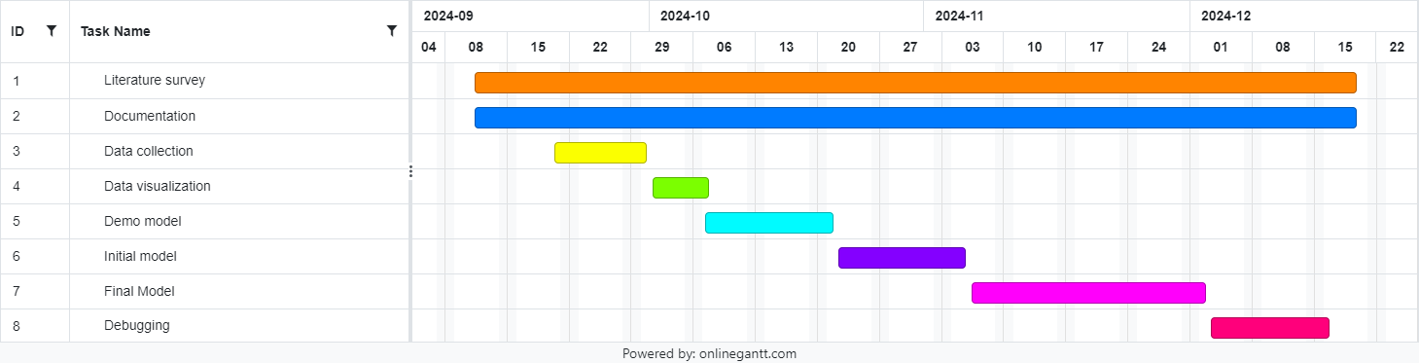
Timeline of Project

Slide 13
Outcomes
Conflict-Free Scheduling: Prevents exam and invigilation overlaps by adhering to constraints like room availability and student course enrollments.
Optimized Resource Use: Matches room capacities with student counts and distributes invigilation duties fairly to avoid overburdening.
Time and Effort Efficiency: Automates manual scheduling tasks, saving time and enabling administrators to focus on strategic activities.
Accuracy and Reliability: Ensures schedules meet institutional policies by adhering to predefined rules, minimizing errors.
Detailed Reports: Produces comprehensive PDFs for exam schedules, invigilation assignments, and student room allocations, improving communication.

Slide 14
Continued…
User-Friendly Interface: Offers a simple web platform for data management, with validation to guide correct input submission.
Flexibility and Adaptability: Supports diverse exam types and custom rules for specific scheduling needs.
Reduced Administrative Burden: Automates tedious tasks and allows quick adjustments for unexpected changes, reducing stress on staff.
Enhanced Stakeholder Satisfaction: Delivers clear and accurate schedules, building trust and satisfaction among students, faculty, and administrators.

Slide 15
Conclusion
The automated exam scheduling system provides an efficient, accurate, and scalable solution to the complexities of manual scheduling. Using a genetic algorithm, it generates conflict-free timetables within minutes, optimizing resources and eliminating errors. Its flexibility allows it to handle large datasets and adapt to institutional rules, while detailed PDF outputs enhance transparency and stakeholder satisfaction. The user-friendly interface and portability ensure accessibility and minimal administrative effort, making it a reliable, cost-effective, and modern tool for academic scheduling.

Slide 16
References
Y. S. Chaudhari, V. W. Dmello, S. S. Shah and P. Bhangale, "Autonomous Timetable System Using Genetic Algorithm," 2022 4th International Conference on Smart Systems and Inventive Technology (ICSSIT), Tirunelveli, India, 2022, pp. 1687-1694, doi: 10.1109/ICSSIT53264.2022.9716370.
M. C. Sárkány and A. Kovács, "Timetable generator and optimizer for Hungarian university students," 2023 IEEE 17th International Symposium on Applied Computational Intelligence and Informatics (SACI), Timisoara, Romania, 2023, pp. 000667-000672
T. Wong, P. Cote and P. Gely, "Final exam timetabling: a practical approach," IEEE CCECE2002. Canadian Conference on Electrical and Computer Engineering. Conference Proceedings (Cat. No.02CH37373), Winnipeg, MB, Canada, 2002, pp. 726-731 vol.2, doi: 10.1109/CCECE.2002.1013031.
Fong, C. W., Asmuni, H., & McCollum, B. (2015). A hybrid swarm-based approach to university timetabling. IEEE Transactions on Evolutionary Computation, 19(6), 870-884.

Slide 17
Continued…
S. K. Siew, S. N. Sze, S. L. Goh, G. Kendall, N. R. Sabar and S. Abdullah, "A Survey of Solution Methodologies for Exam Timetabling Problems," in IEEE Access, vol. 12, pp. 41479-41498, 2024
H. Kanemitsu, M. Hanada and H. Nakazato, "Clustering-Based Task Scheduling in a Large Number of Heterogeneous Processors," in IEEE Transactions on Parallel and Distributed Systems, vol. 27, no. 11, pp. 3144-3157, 1 Nov. 2016
R. Nand, E. Reddy, K. Chaudhary and B. Sharma, "Preference-Based Stepping Ahead Firefly Algorithm for Solving Real-World Uncapacitated Examination Timetabling Problem," in IEEE Access, vol. 12, pp. 24685-24699, 2024, doi: 10.1109/ACCESS.2024.336573
D. Srinivasan, Tian Hou Seow and Jian Xin Xu, "Automated time table generation using multiple context reasoning for university modules," Proceedings of the 2002 Congress on Evolutionary Computation. CEC'02 (Cat. No.02TH8600), Honolulu, HI, USA, 2002, pp. 1751-1756 vol.2, doi: 10.1109/CEC.2002.1004507.

Slide 18
Continued…
K. Gkiotsalitis and O. Cats, "Timetable Recovery After Disturbances in Metro Operations: An Exact and Efficient Solution," in IEEE Transactions on Intelligent Transportation Systems, vol. 23, no. 5, pp. 4075-4085, May 2022, doi: 10.1109/TITS.2020.3041151.
X. Jin et al., "Real-Time Scheduling of Massive Data in Time Sensitive Networks With a Limited Number of Schedule Entries," in IEEE Access, vol. 8, pp. 6751-6767, 2020, doi: 10.1109/ACCESS.2020.2964690.

Slide 19
Publication Details
Title: Examination Timetable Generation
Authors: Susheeth G, Ritish N, Vidyashree B N, Mithali S Anand, Tejashwini B A
Published URL : https://ijirt.org/Article?manuscript=171957
Publication Date : 08-Jan-2025

Slide 20
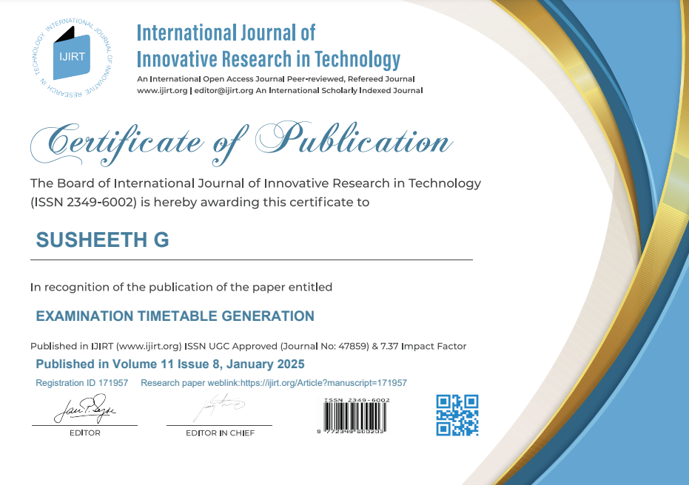
Achievements (if any)

Slide 21
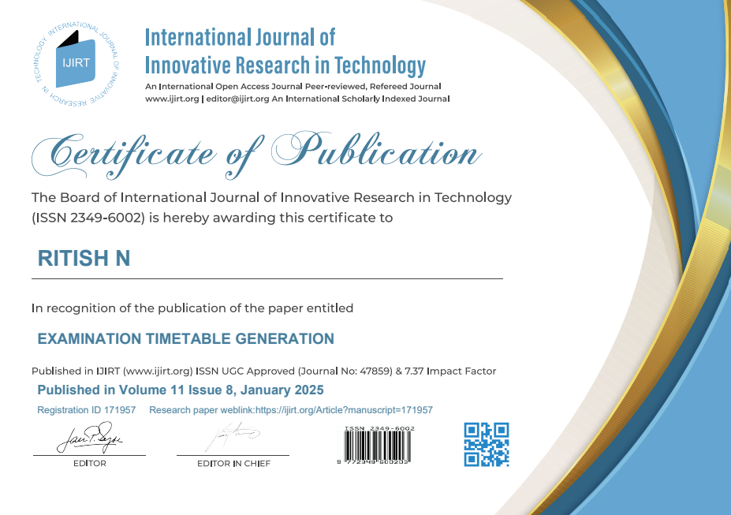

Slide 22


Slide 23


Slide 24


Slide 25

Thank You

